Slide 1
Today’s lecture
How is semiotics – “the science of signs” – a science?
How is semiotics an example of structuralism?
What were the historical circumstances in which structuralism came into existence?
Why is understanding structuralism important for understanding how systems of signification command so much power?

Slide 2
Signs are ARBITRARY
Signs do not have inherent meaning outside of the systems that give them meaning: “There is nothing tree-like about the word ‘tree’” (Chandler, 24)
Signs acquire meaning through convention and habit and routines (of language)
In this sense, Saussure argues than signs are arbitrary
Systems of signification do not represent reality or reflect reality; they construct reality

Slide 3


Within a system of signification, the arbitrary relationship between signifier and signified takes on a common-sense quality because of convention, habit, and routine

Slide 4
Within a system of signification, the arbitrary relationship between signifier and signified takes on a common-sense quality because of convention, habit, and routine
Case #1: Social greeting as convention
Case #2: Marriage vows as convention
“I do”
“How’s it going?”

Slide 5
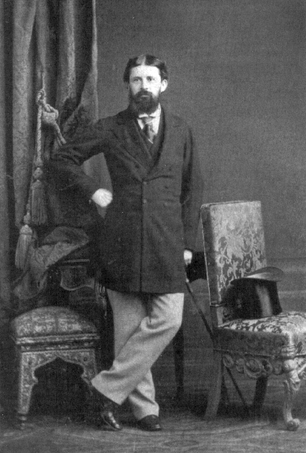
Charles Sanders Peirce (US, 1839-1914 )
Philosopher and mathematician known for studying logic
Developed his own model of semiosis in the 1860s, decades before Saussure
In contrast to Saussure’s dyadic (two-part) model of the sign (signifier: signified) Pierce offers a triadic (three-part) model of the sign—the equivalent of signifier: signified with a third term, referent. The referent is what the other two parts stand for.

Slide 6
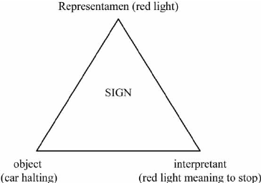

Slide 7
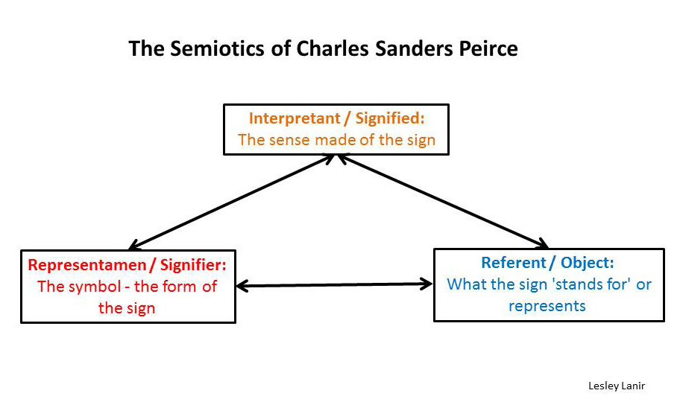

Slide 8
Value of external reality for Peirce
Peirce’s third term – the referent – introduces the idea that external reality does not only exist but is important in making meaning, thereby challenging Saussure’s interest only in the internal system of signification
As a philosopher and not a linguist, the Peircean model suggests that interpretation was an active part of Peirce’s understanding of what signs are (or should be)
But Peirce was not interested in individual (or subjective) interpretation as much as he was interested in how social interpretation takes shape through conventions, habits, and routines
“Semiosis is socially regulated, transcending individuals. In the physical world, the counterparts of habits are natural laws or regularities. Peirce thus proposes that limits to interpretation derive from both nature and culture” (Chandler, 35)

Slide 9
Value of external reality for Peirce
“Semiosis is socially regulated, transcending individuals. In the physical world, the counterparts of habits are natural laws or regularities. Peirce thus proposes that limits to interpretation derive from both nature and culture” (Chandler, 35)

Slide 10
Peircean models of referentiality
In his work, Peirce developed relational models of signification that are described as referential
Symbolic: arbitrary and conventional relationship between signifier and signified (e.g. alphabet; traffic light)
Iconic: perceived resemblance or imitation between signifier and signified (e.g. sound effect; cartoon of person)
Indexical: inferred connection between signifier and signified (e.g. medical symptoms; ringing telephone)

Slide 11
The significance of symbolic signs
“Symbolic signs are usually understood to be intended to communicate something. Their intended meanings are not intuitively obvious; understanding symbolic signs depends wholly on our familiarity with the relevant conventions (without which they may fail to signify or be misinterpreted). We interpret symbols according to a ‘habitual connection’, ‘a rule,’ or ‘a law, usually an association of general ideas, which operates to cause the symbol to be interpreted as referring to that object’” (Chandler, quoting Peirce, 46; italics Chandler’s)

Slide 12
How is “the science of signs” a science?
Peirce’s approach (and, later, Saussure’s approach) to “the science of signs” is a good example of the rise of structuralist thinking in the mid-nineteenth century
Structuralism: an approach to the world that attempts to find and elucidate structures of meaning as well as the social, cultural, and behavioral models that humans have developed to make meaning of reality
Many of the social sciences – sociology, linguistics, psychology, anthropology, political science, economics – that came of age in the late nineteenth/early twentieth are examples of structuralist thinking
The legacy of structuralist thinking continues to have an impact across the humanities, social sciences, and even the “hard sciences” (e.g. genomics)

Slide 13
What brought structuralism into existence?
Enormous political, economic, and social upheavals in the nineteenth and twentieth century encouraged intellectuals, scientists, and political leaders to try to find models that would explain (and possibly predict) historical change (e.g. revolution) as well as explain (and possibly predict) human behavior
While the desire to find underlying principles, or structures, that explain or predict the external world could be said to be an ancient one, the belief that one could find such principles or structures scientifically could be seen as the ultimate expression of modernity
Some of these models could be called scientific while others could be called pseudo-scientific

Slide 14
Some structuralist models
Theories of evolution (Darwin)
Theories of revolution and historical change (Marx and Engels)
Theories of genetic transmission (Mendl; later Crick and Watson)
Theories of semiosis (Peirce; Saussure)
Theories of criminality (Lombroso)
Theories of human mind and consciousness (Freud)
Theories of behavior (Pavlov)
…and some structuralist models
The Periodic Table (Mendeleev, 1869)
The IQ Test (Binet & Simon, 1904)
The Kinsey Scale (Kinsey, 1948)

Slide 15
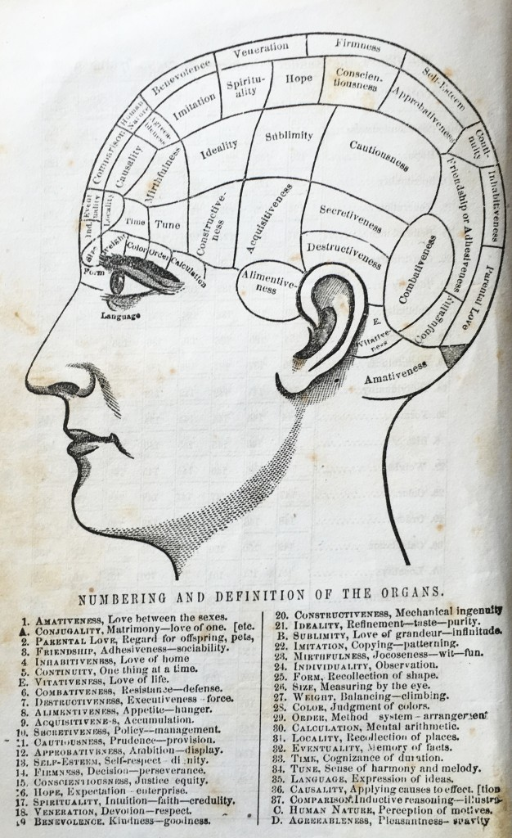
Structuralist models and scientific truth claims
In the 1830s, the development of phrenology took the US and Europe scientific and intellectual communities by storm
For phrenologists, the shape and size of a human skull could be “read” as an objective reflection of not only individual “character” but of racial/ethnic value
Phrenology has been called a pseudo-science, but it remains an example of how structuralist models can be highly influential

Slide 16
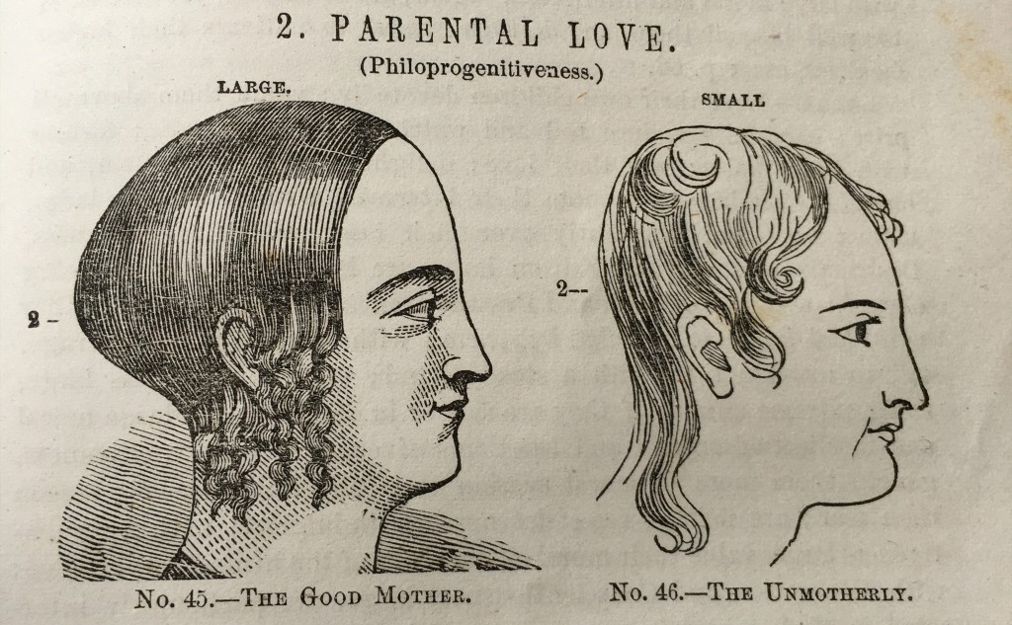
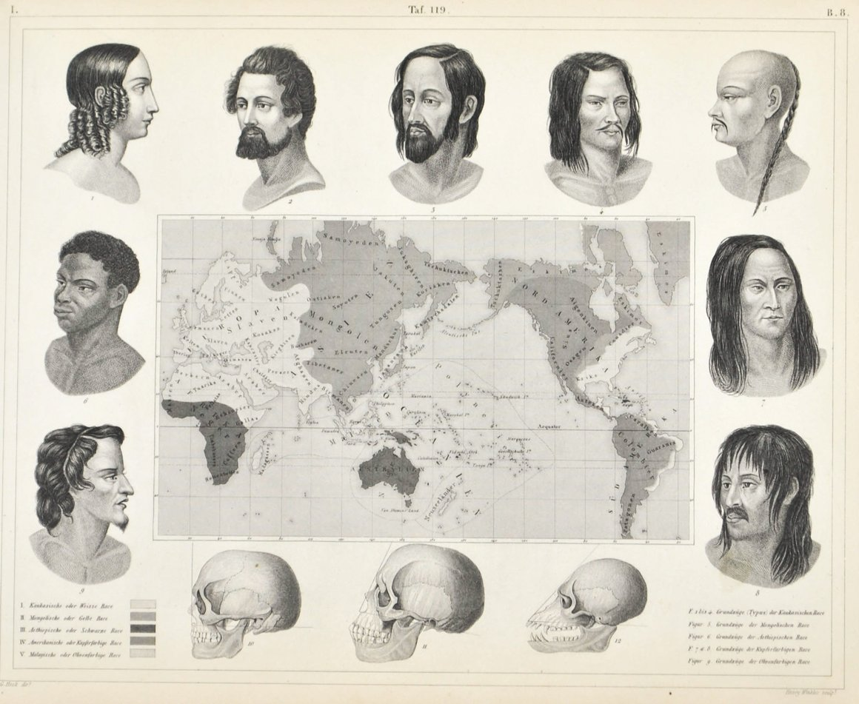
Structuralist models and scientific truth claims

Slide 17
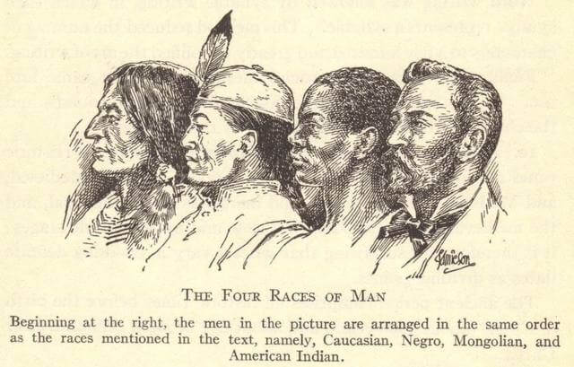
Structuralist models and scientific truth claims

Slide 18
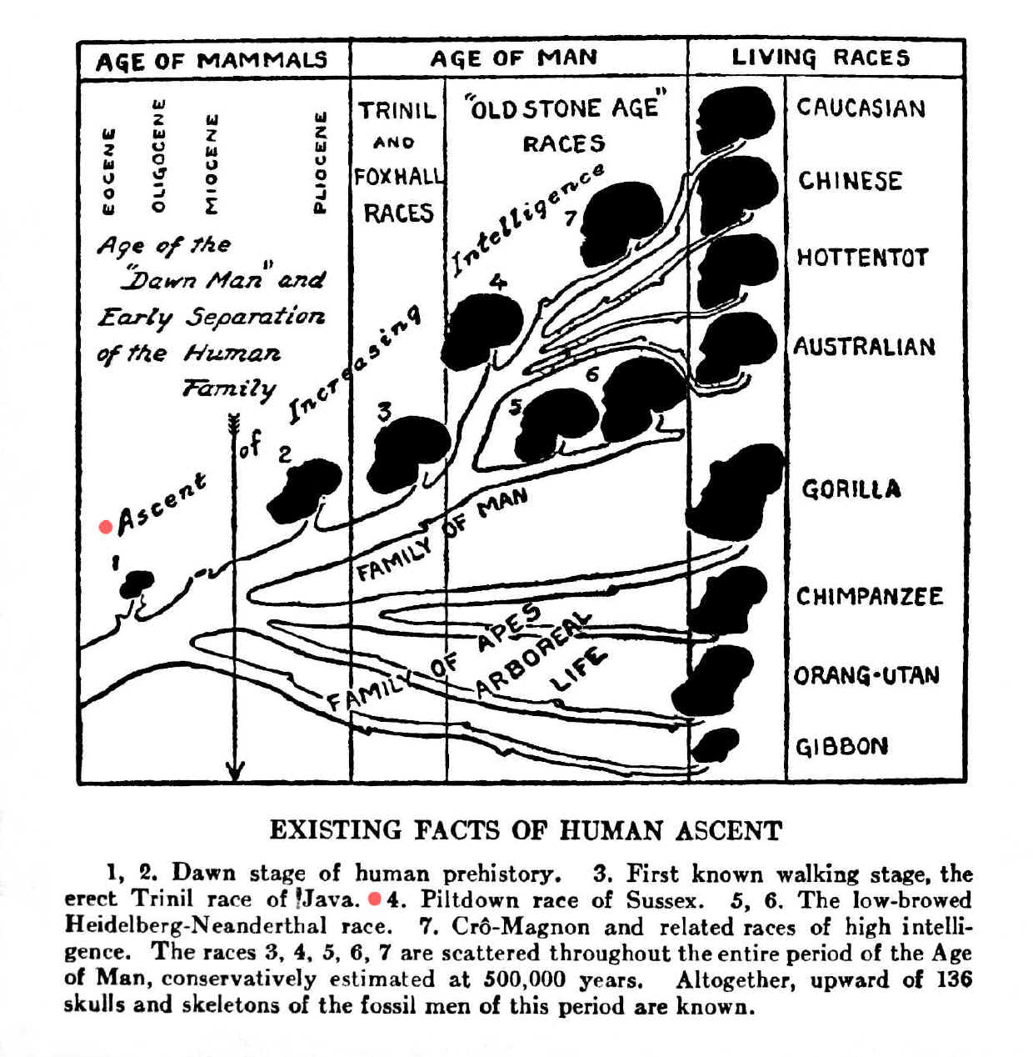
Structuralist models and scientific truth claims

Slide 19
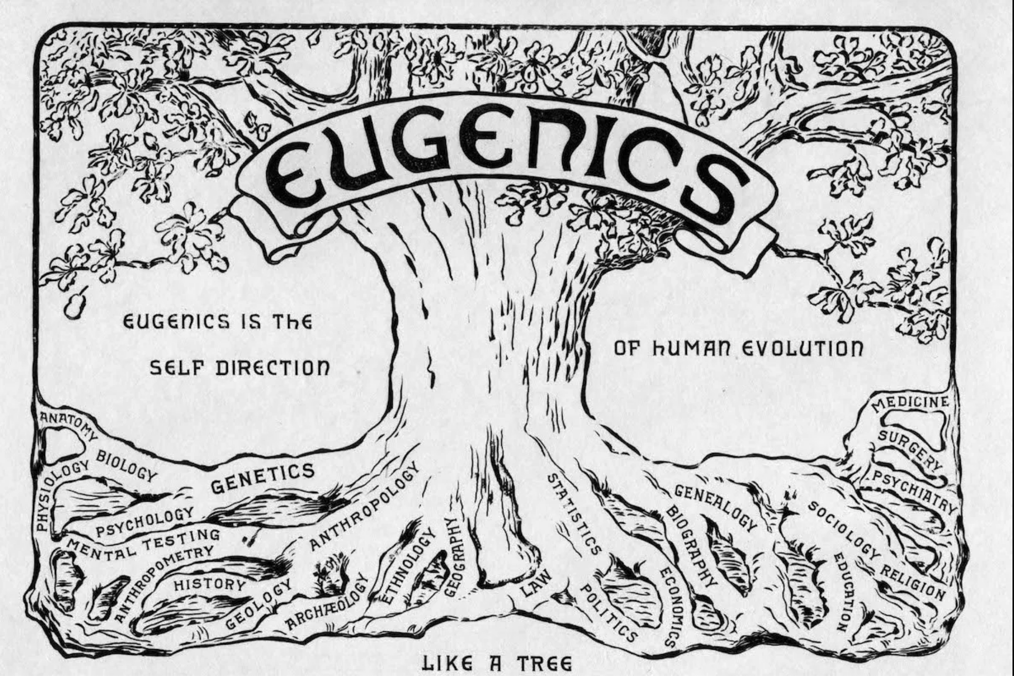
Structuralist models and scientific truth claims

Slide 20
Semiotics is not an absolute science
Like many structuralist models, semiotic theories are never absolute but useful models
For the linguist Saussure, the goal of semiotics is to IDENTIFY signs and TRACE systems of signification, not WHAT those signs mean
For the philosopher/mathematician Peirce, the goal of semiotics is to IDENTIFY signs and TRACE systems of signification and also to determine HOW humans make meaning, not WHAT those signs mean
“The real object corresponding to the sign is absolutely irrelevant to any semiotic purpose…[T]he referent of a sign is…an abstract entity which moreover is only a cultural convention” (Eco, 1973)

Slide 21
For the structuralist, the meaning of a thing is HOW meaning is produced within a system of signification, not WHAT it means
“The real object corresponding to the sign is absolutely irrelevant to any semiotic purpose…[T]he referent of a sign is…an abstract entity which moreover is only a cultural convention” (Eco, 1973)

